Slide 1
PRETEST APP

Slide 2
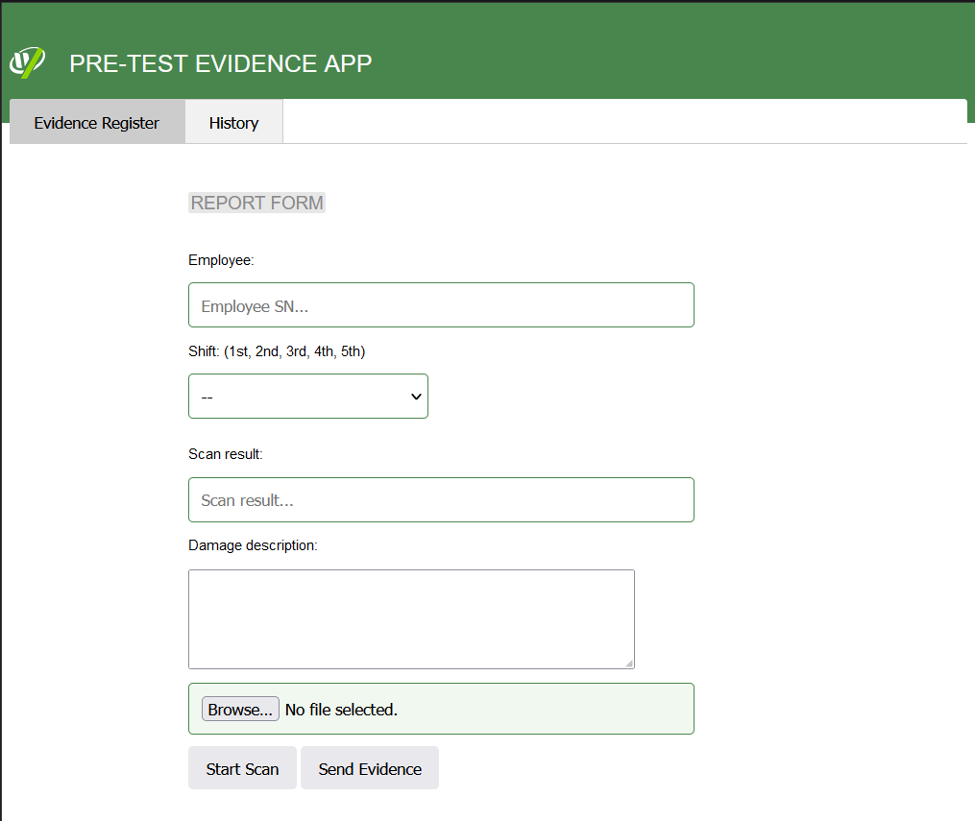
PRINCIPAL PAGE
THIS APP WAS DEVELOPED FOR RECORD ALL POSSIBLE PHYSICAL DAMAGE ARROUND THE L10 ASSEMBLY. HERE DOES SHOWS THE PRINCIPAL PAGE ABOUT IT.
LINK:
http://10.250.37.193:8080/pretestqr/
HERE THERE ARE TWO TABS, ‘EVIDENCE REGISTER’ AND ‘HISTORY, THE FIRST ONE IS USED TO REGITER A NEW EVIDENCE.

Slide 3
PRINCIPAL PAGE
THRE ARE FIVE FIELDS FOR DESCRIBE THE L10 DAMAGE, EACH ONE IS MANDATORY, (EMPLOYEE, SHIFT, SCAN RESULT, DAMAGE DESCRIPTION, AND IMAGE EVIDENCE).
THERE ARE TWO BUTTONS TOO, (START SCAN AND SEND EVIDENCE), DESCRIBED IN TO THE NEXT SLIDE.

Slide 4
PRINCIPAL PAGE
THE ‘SEND EVIDENCE’ BUTTON, ONLY SENDS TO RECORD THE EVIDENCE INTO THE DATA BASE.
THE BUTTON ‘START SCAN’, OPEN THE CAMERA TO SCAN THE BARCODE OR QR FROM THE L10.

Slide 5
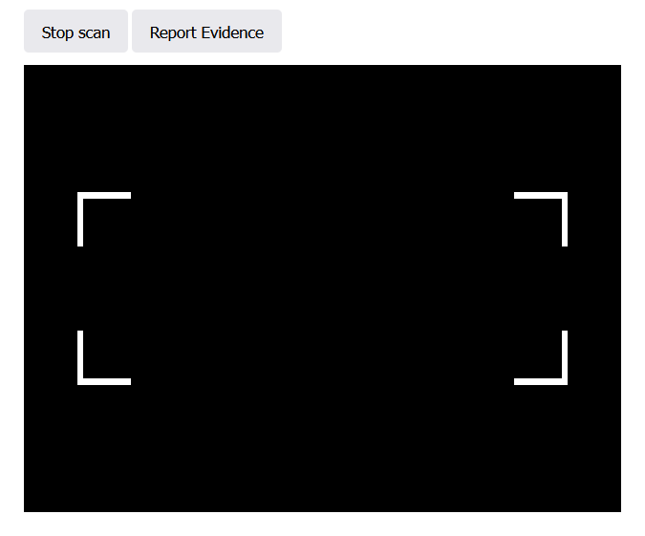
PRINCIPAL PAGE
WHEN THE CAMERA IS ACTIVATED, THE USER CAN STOP IT BY PRESSING ‘STOP SCAN’ BUTTON.

Slide 6
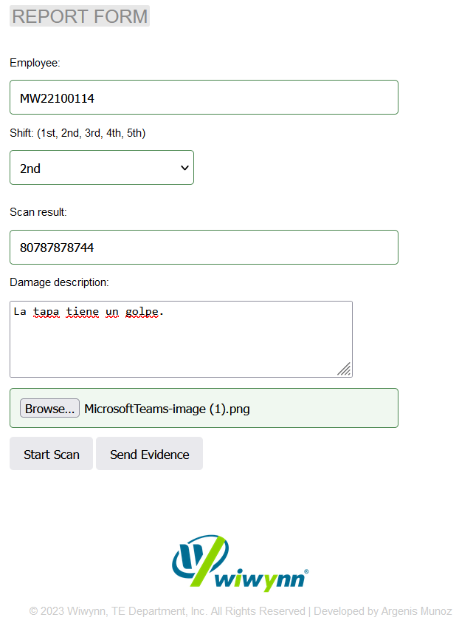
PRINCIPAL PAGE
ONCE OF THE FORM IS FULLY COMPLETED, THE USER HAVE TO PRESS THE BUTTON ‘SEND EVIDENCE’

Slide 7
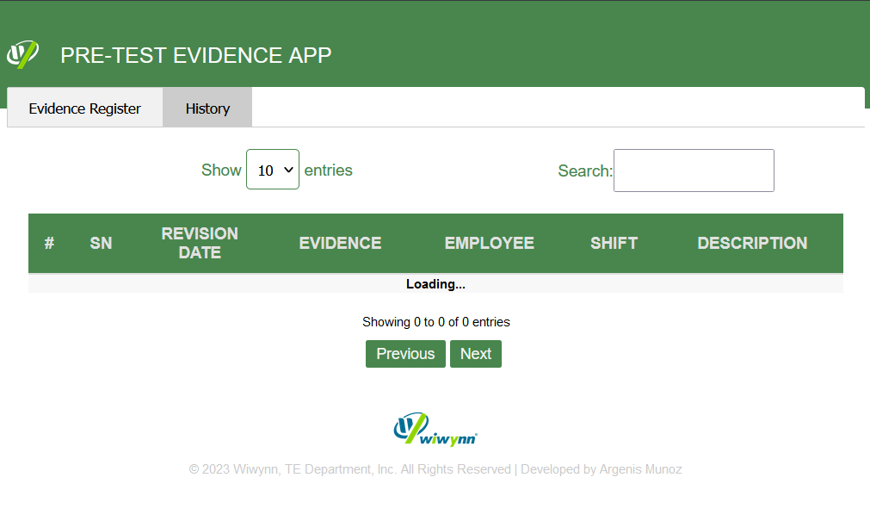
HISTORY PAGE
THIS PAGE ONLY SHOWS THE HISTORY ABOUT DAMAGE L10 REGISTRATION.
THE USER CAN SEARCH BY USING THE FILTER FIELDS ABOVE THE TABLE.

Slide 8
Thanks!!!

